Slide 1
AAGI Interview
Bappaditya Debnath(Rick)
AAGI Candidate

Slide 2
Hyperparameter Tunning
Methods
Random Search (Intuition)
Grid Search
Bayesian Optimisation
Hyperband
Tools
Bayesian Optimisation
Ax-platform
Optuna
Parameter -> Model
Score
Parameter search space
Tool
Best Parameters
Notes:
Bayesian: The main ingredient is a probabilistic surrogate model, which consists of a prior distribution that captures our beliefs about the behavior of the unknown objective function.
Hyperband: Hyperband is essentially a variation of random search that uses principled early-stopping strategy and an extension of the SuccessiveHalving algorithm to allocate resources.

Slide 3
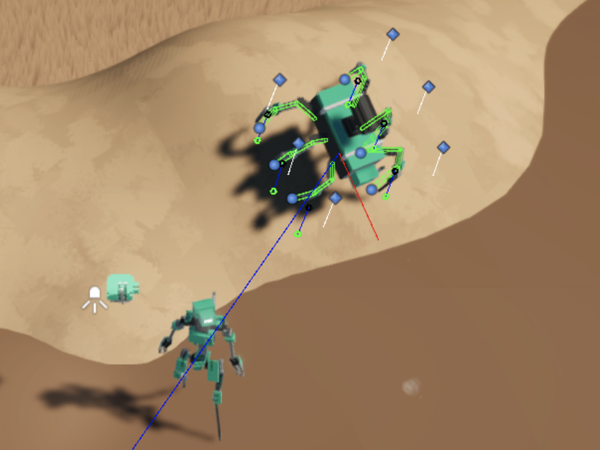
Target objects in Terrain(TOT)
Multiview detection
Pose Estimation
Context-aware

Slide 4
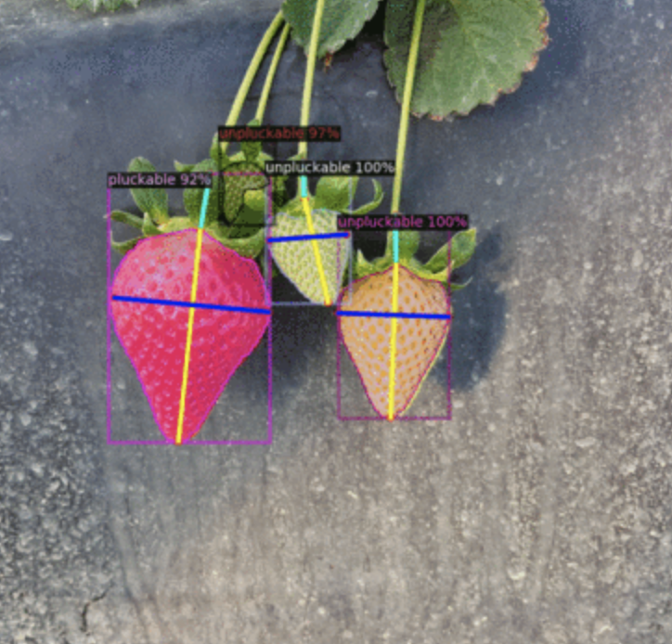
TOT: Pose Estimation (Key-point detection)
2D pose Estimation:
2D Pose Nets (Openpose)
6D Pose estimation (RGB + Depth)
Point GNN
Point Pose Net
Pose integrated with segmentation
Detectron2: Object detection, segmentation and bbox

Slide 5
TOT: Multiview-detection
Capture multiple views of the same scene containing objects
FPN helps detection at multiple scales
DETR 3D is a good example
BBOX 1
View 1
ResNet + FPN
View 2
ResNet + FPN
NN
BBOX 2
View N
ResNet + FPN
BBOX N

Slide 6
Invasive vegetation
ACQUISITION
DATA ENHANCEMENT
IMAGE SEGMENTATION
MODALITY
Hyperspectral
CCTV/Surveillance
Texture Generation
Transformers
Background subtraction
Colour
Drone Imaging
Mask-RCNNs
Cycle/Bicycle GAN

Slide 7
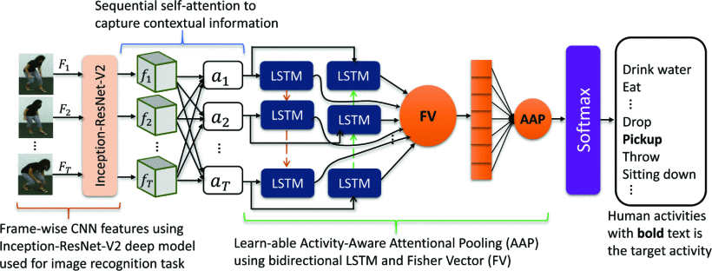
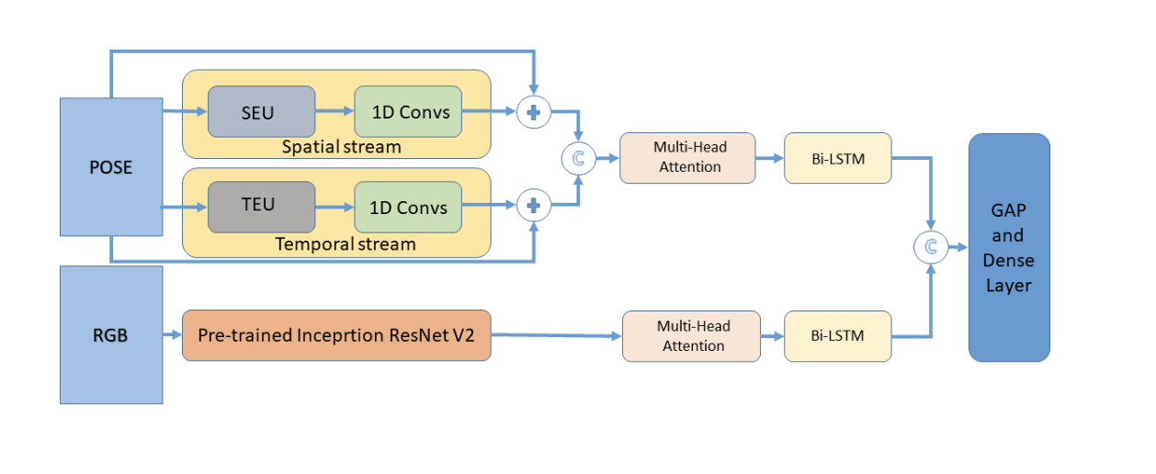
Attention Mechanism
K
S
O
F
T
M
A
X
CV
V
Similarity (DOT)
Q
CV
V

Slide 8
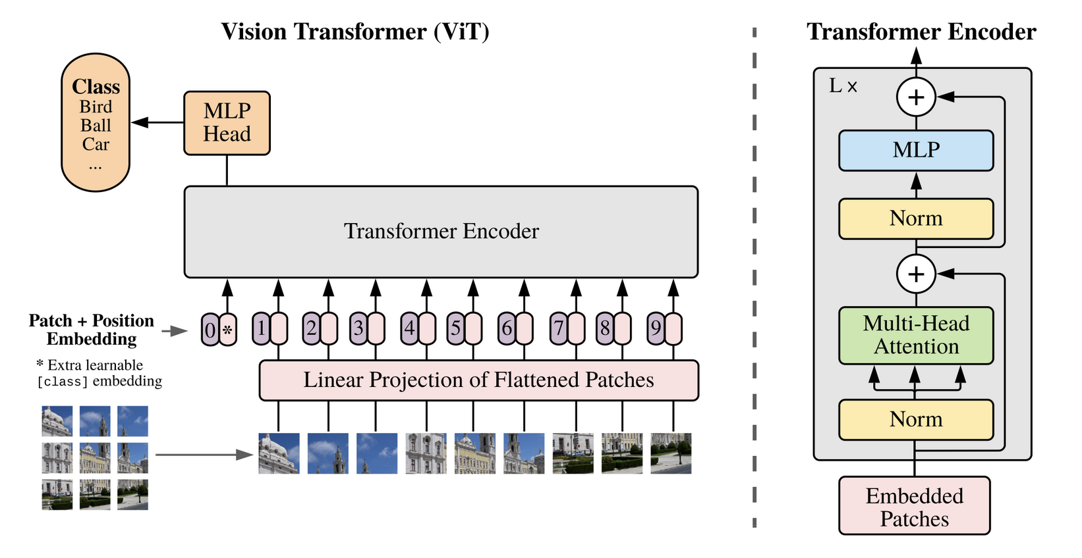
Transformer
Pre-Steps:
Patch Embedding . 224*224 (16 x16 words). 196 * 768 (hyper-param)
Classification token (learnable parameter)
Position embedding (spatial awareness)
Transformer block
Classification/Detection block

Slide 9
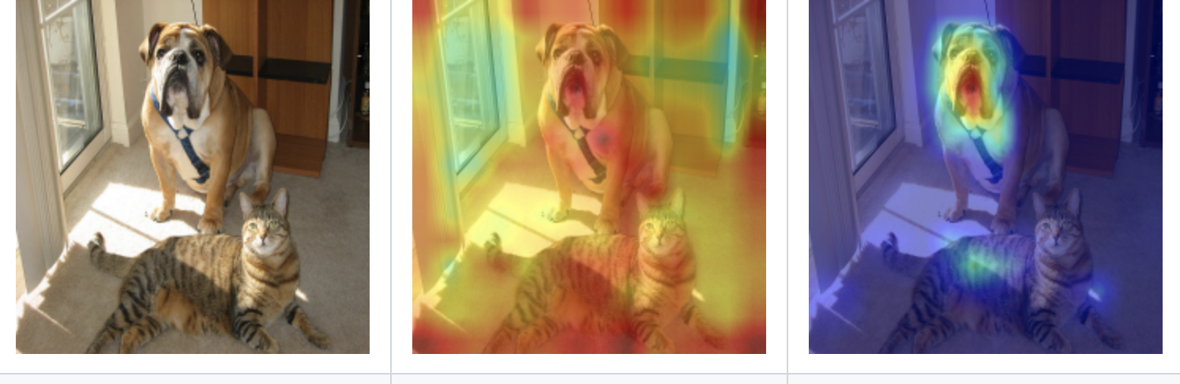
Attention maps
Visualise the relative importance of layer activations each spatial location.
Process layer output through attention mechanism.
Visualise the probabilities output by the attention layers

Slide 10
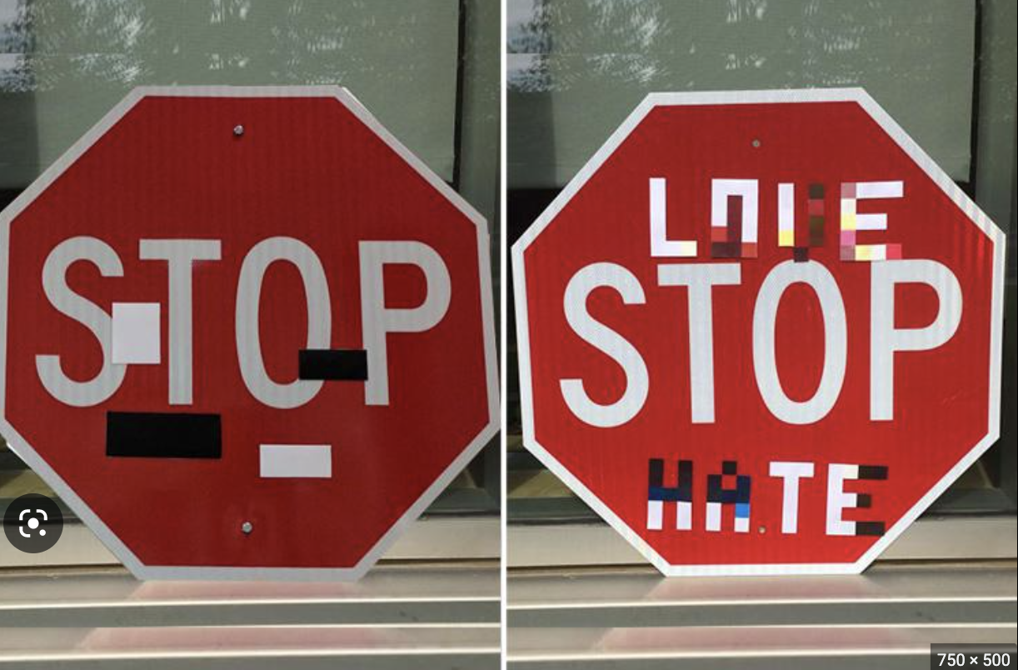
Noise
Vulnerability:
Models learn pattern not noise.
Specific neurons may not learn.
These neurons may react to noise.
Exploitation:
Model Inversion.
Data recovery.
Safety
Attacks:
Perturbation attacks.
Adversarial attacks.
Data Poisoning.
Solution:
Model the noise (Diffusion models).
Train with adversarial examples.
Pay attention to attention maps
Interpretability

Slide 11
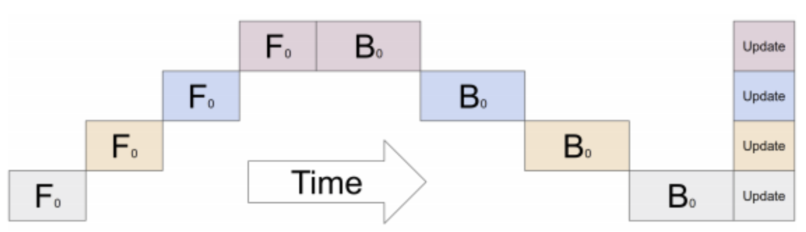
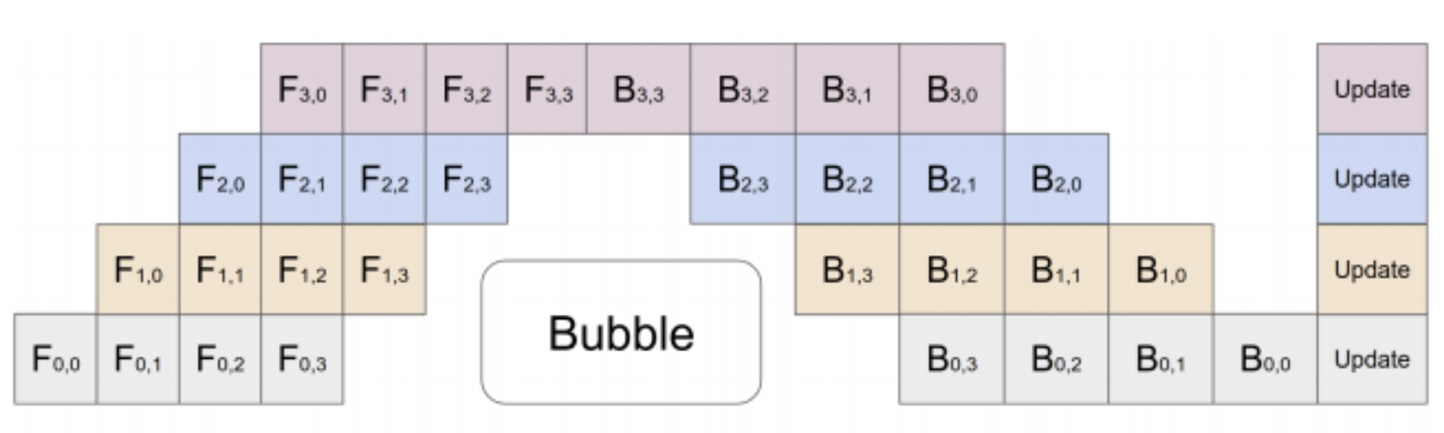
Distributed Training
Data Parallelism: Dataset split into ‘N’ parts
Model Parallelism: Model split into ‘N’ parts
Pipeline parallelism: splits the input minibatch into multiple micro-batches
Model Parallelism
Pipeline Parallelism

Slide 12
THANKS

